Slide 1
Lip augmentation
med. Birgit Muylle
8 July 2019

Slide 2
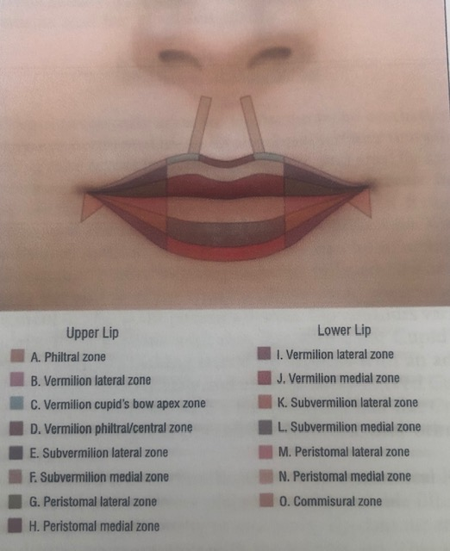
Introduction 1. Anatomy
Knowledge lip zones (Jacano A., 2008)
Determine filler placement
Evaluate size and contouring
Upper lip: philtrum, 2 lateral units
Lower lip: 1 subunit
Vermillion border - white roll
Ideal (De Maio et al., 2014)
V-shape Cupid’s bow
Full medial tubercles
Vermillion border clearly
Ratio upper / lower lips: 1:1,618
Image: Lip zones (Jacano A., 2008)

Slide 3
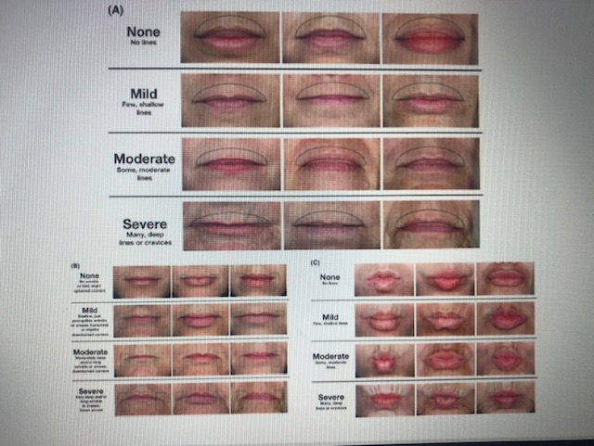
2. Grading Scale
Cohen et al, (2014):
Lips as unit
peri-oral lines at rest and during contraction (POL(M))
oral commissure and marionette lines scale (OCS)
Objective
Before – after images
Efficacy
Longevity

Slide 4
Methods 1. Lip fillers
HA fillers first choice (Carruthers, 2018)
Less incidence nodule or granuloma formation
Temporary side effects
Hyaluronidase
HA fillers (De Maio et al., 2014)
Fuller plumper lips: volume and structure
Definition vermillion border : shape
Treatment peri-oral fine lines
Mean longevity (Walker L., 2016)
Juvéderm Volbella, Restylane, Teosyal RHA: 12 months
Belotero Intense: 6 – 9 months

Slide 5
2. Patient selection
Best results (De Maio, 2014)
Younger patients
Preserved lip landmarks
Good health
Non-smoker
No intervention
Doubts, anxious
BDD
Active infection, history ? -> herpes: prevention oral antivirals before intervention
Diabetes
Walker, L. (2016):
Question: why do you want to modify your lips
Realistic expectations?
Social media influence?

Slide 6
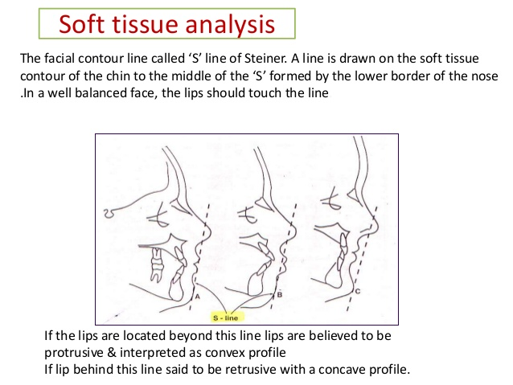
3. Physical examination
Analysis of frontal view and profile (Carruthers et al., 2018)
Static
Steiner Line
Dental arches
Dynamic
Gummy smile : no fillers, BTX m. Levator labii sup (alaeque nasi)
Aging signs:
Upper lip: thin elongated, loss show upper teeth
Lower lip: thin rolls inward, more show lower teeth
Pink vermillion and cupid’s bow disappear
Hyperactivity m. depressor anguli oris
Deeper peri-oral lines due m. oris orbicularis
Total view of face harmony (De Maio, 2014)
Correction of downturned mouth corners
BTX m. depressor anguli oris
Fillers underneath lateral mouth corners (support function)
Fillers peri-oral lines
Image: Rahman, N. (2015)

Slide 7
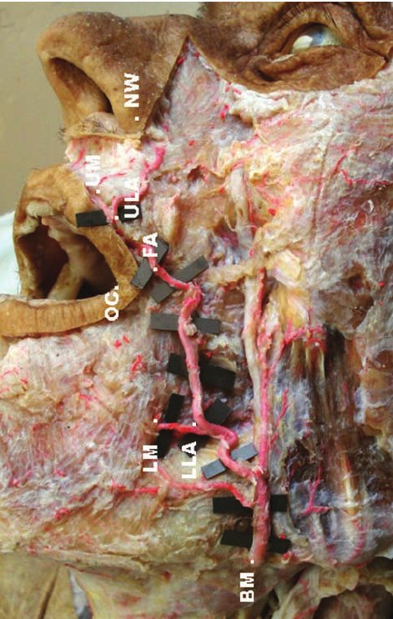
4. Technique
Needle or cannula?
Needle 27G vermillion border and philtrum
Cannula 25G
Thinner lips
Older patients
HA gel behind the muscle (labial arteries)
With lidocaine or due nerve block injections
Complex nerves painful
Upper lip infra-orbital nerve
Lower lip n. mentalis
Be aware of FA (a. facialis), ULA (upper) and LLA (lower labial a.)
Recommendations : 1 – 2 ml, > 2 – 3 ml: higher risk moderate to severe adverse events, unnatural results
Image: Suazo, I.(2008)

Slide 8
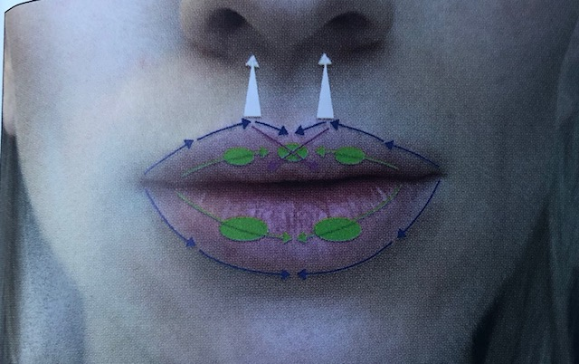
‘Younger patients are seeking for enhancement. Older for restoration.’
(Carruthers et al., 2018)
(Chiu et al., 2016)(Carruthers et al., 2018)(De Maio, 2014)
Needle lateral to medial, retrograde fashion, massage and ice after injections
Vermillion border (frame lips, white border) and Cupid’s bow : lip definition
Along vermillion border to G-K points in Cupid’s bow
Define due little amount of filler in Cupid’s bow too (pink lines)
Before voluminizing the bodies
Voluminize body (green lines)
Upper lip lower lip ratio 1:1,6
Duck face: too much filler medial tubercle
Philtral columns
Inserted at G-K points, along columns
Lateral inferior to medial superior
Image: Carruthers et al. (2018)

Slide 9
5. Aftercare
Ice ease discomfort and control swelling
No pressure lips
No lipstick or other products
Side effects bruising and swelling temporary (few days)
In case of complications call 24/7 aesthetic doctor

Slide 10
6. Complications
Due to injection
Erythema, bleeding, bruising, edema and pain – some days – ICE
Reactivation herpes simplex virus – Acyclovir/famciclovir/valacyclovir: oral antivirals
Due to technique
Asymmetry, contour irregularity, over/undercorrection – touch-up 1-14 days after
Vascular occlusion, embolism, necrosis – asap hyaluronidase
Due to product
Inflammation, infection – ICE, NSAID
Lump and nodule formation – massage, hyaluronidase
Granuloma
(Carruthers et al., 2018) (De Maio et al., 2014)

Slide 11
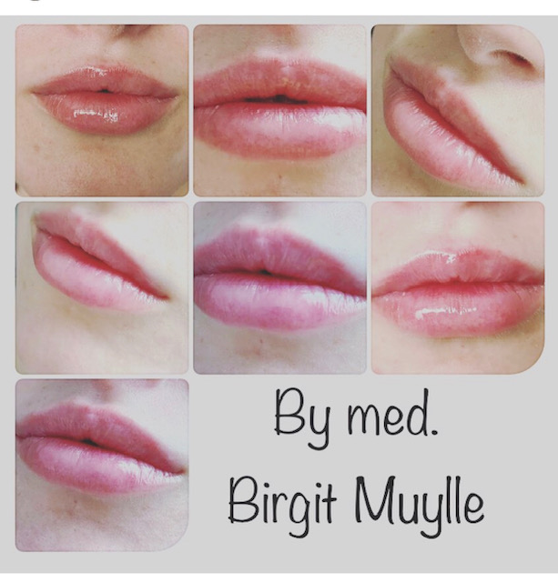
Conclusion
HA fillers
Less is more
Lip definition vermillion border and Cupid’s bow. Voluminizing bodies,
Bruising and swelling
Arteries!

Slide 12
References:
Carruthers et al. (2018). Procedures in cosmetic dermatology :soft tissue augmentation.New York: Elsevier, pp 141 -147
Chiu et al. (2016). ‘Lip injection techniques using small particle hyaluronic dermal filler’, Journal of drugs in dermatology, 15(9): pp 1076 – 1082
Cohen et al. (2014), ‘An interrater and intra-rater reliability study of 3 photographic scales for the classification of perioral aesthetic features’, Dermatological Surgery, (online). Available at: https://www.ncbi.nlm.nih.gov/pubmed/24852471(Accessed 19th July 2019)
De Maio et al. (2014). Injectable fillers in aesthetic medicine. New York: Springer, pp 114 - 122
Jacono, A. (2008) ‘A new classification of Lip Zones to costumize injectable lip augmentation’, Arch Facial Plast Surg, 10(1): pp 25-29
Rahman, N (2015) ‘Steiners analysis’, Slideshare (online). Available at: https://www.slideshare.net/meghdubi/steiner-analysis-48319042 (Accessed on the 7th of July 2019)
Rossi, AB et al. (2010) ‘Development and validation of a photonumeric grading scale for assessing lip volume and thickness’, Journal of the European Academy of Dermatology and Venerology, (online) Available at: https://onlinelibrary-wiley-com.ergo.southwales.ac.uk/doi/pdf/10.1111/j.1468-3083.2010.03816.x (Accessed on the 6th of July 2019
Suazo, I.(2008) ‘Biometrics study of the upper and lower labial artey in human cadavers’, Int Journ of morphology, 26 (3), 573 - 576
Walker, L (2016) ‘Lip augmentation’, Aesthetics, (online) Available at: https://aestheticsjournal.com/feature/lip-augmentation ( Accessed on the 6th of July 2019)

