Slide 1
Botulinum toxin, a therapeutic intervention in depression
Med. Birgit Muylle
May 2019
Total words: 563

Slide 2
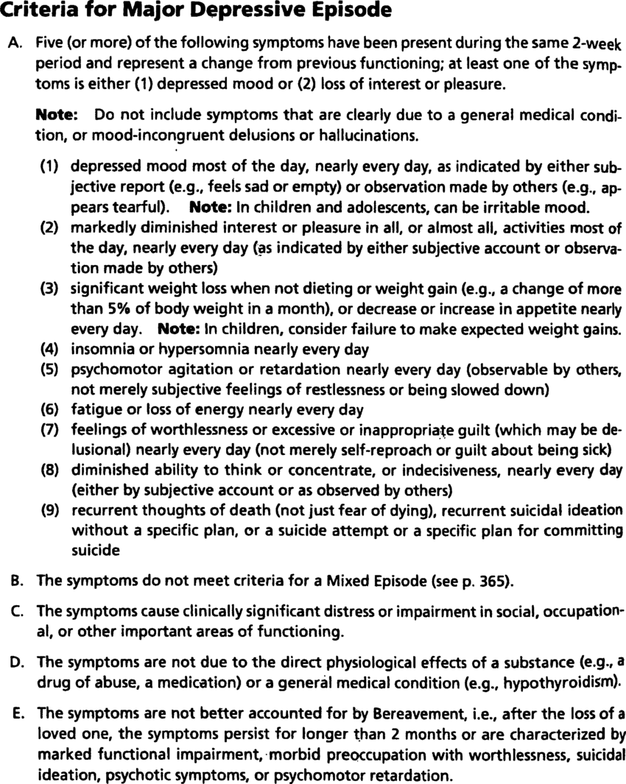
DSM-IV Major Depressive Disorder
Tolentino et al, 2018:
Persistent feelings of sadness, hopelessness and anhedonia
Secondary problems
Clinical impairments
Summary : www.researchgate.net/figure/Diagnostic-criteria-for-major-depression-DSM-IV-TR-p-356_fig1_6284522

Slide 3
Multidisciplinary management
Major depression resistant to the classic pharmacologic and psychotherapeutic approaches.
Drugs: adverse events
Btx: alternative?

Slide 4
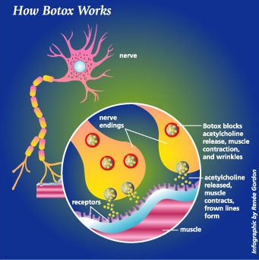
Botulinum toxin (BTX)
Neurotoxin blocks acethylcholine release (muscle paralysis)
Medical applications
FDA approved aesthetic applications: glabellar wrinkles (type A)
Safe
Image: drugline.org/img/term/botulinum-toxin-2095_0.jpg

Slide 5
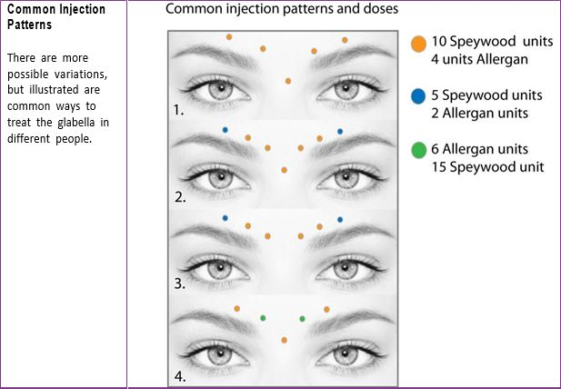
Mechanism of action: Facial Feedback Hypothesis
Charles Darwin (1872):
‘Emotions trigger physiological changes in the body’
William James (1884):
‘The sensation of bodily changes influence the emotional state’
changes in facial expression due BTX can influence affect?

Slide 6
BTX A Glabella vs placebo*
Finzi et al, 2006: first reported case: 10 women 29U
Decrease symptoms of depression 2 months after injection
Wollmer et al, 2012: first RCT: 29/39U women/ men (n=30)
Significant results 6 weeks after injection: 50% reduction within week 2
BTX A adjunctive therapy
Finzi et al, 2013: RCT: (n=74): 29/40U women(n=69)/ men
Increase remission at 6 weeks
Patients not resistant to anti-depressiva have benefits
BTX adjunctive therapy
No significant relation: frown scores and improvement depression, gender
Hexsel et al, 2013: open label study: 20-40U (n=25)
Positive result self-esteem and depression
Magid et al, 2014: 29/39U (n=30) with 28 women
Depression symptoms decrease after 6 weeks, even when cosmetic changes are gone ( 24 weeks)
* See references,

Slide 7
Boudreau et al, 2015: effect mild depressive symptoms with chronic migraine (n=32). Injection sites migraine 155U head and neck
Significant improvement depression symptoms and headache.
Discussion relationship
Zamanian et al, 2017: (n=28) major depression
Improvement at 6 weeks not earlier
Allergan Phase 2 , 2017: compare 30 and 50U, 258 women, control at 3-6-9 weeks
30U: significant results at 3 and 9 week
50U: no significant difference with placebo
Chugh et al, , 2018: (n=42, 55% men), effect BTX A patients severe treatment resistant depression, BTX A adjuvent hterapy
Week 3, significant improvement in both gender
No placebo group?

Slide 8
“ Refuse to express a passion and it dies.” (Wiliam James)
Wollmer et al, 2012:
BTX positive effect moods. Negative emotions not allowed due muscles paralysis (corrugator and procerus).
Franca et al, 2016:
1, A pleasant expression is attractive, influencing social interactions and self-esteem
2, Neurochemical changes in the brain: the amygdala less responsive to negative stimuli
Finze et al, 2013 and Magid et al, 2014:
No relationship between aesthetic outcome and decrease of symptoms of depression >< Franca et all, 2016

Slide 9
Summary
Significant results at 6 and even after 24w
Adjunctive therapy
No relation aesthetic outcome
No difference in gender
Higher dose not efficacy

Slide 10
References:
Finzi et al (2006) ‘Treatment of depression with botulinum toxin A: a case series’, Dermatologic surgery (2006), 32(5), pp 645 – 650
Wollmer, A. et al (2011) ‘Facing depression with botulinum toxin: a randomized controlled trial, Journal of Psychiatric Research (2012), 46, pp 574-581
Magid, M et al (2014) ‘Treatment of major depressive disorder using botulinum toxin A: a 24-week randomized, double-blind, mlacebo-controlled study’, J Clin Psychiatry (2014), 75(8), pp 837-844
Kruger, T. et al (2015) ‘Depression – an emerging indication for botulinum toxin treatment’, Toxicon (2015), 107, pp 154-157
Magid, M. et al (2015) ‘Botulinum toxin for depression? An idea that’s raising some eyebrows’ (2015), current psychiatry, 14(11), pp 43,46,51-56
Franca, K. et al (2016) ‘Botulinum toxin for the treatment of depression’, Dermatologic Therapy (2017), 30
Chugh, S. et al (2018) ‘Botulinum toxin as a treatment for depression in a real-world setting’, J of psychiatric practice, 24(1), pp 15-20
Tolentino, J. et al (2018) ‘DSM criteria and depression severity’, Front Psychiatry (2018), 9, art. 450
Junghyum, K. Et al. (2018) ‘Botulinum toxin: emerging psychiatric indications. Botulinum toxin has shown promising anti-depressant effects, and might be helpful for several other indications.’, Current Psychiatry (2018), 17(12), pp 9-17

